Slide 1
RIF Docking status and plans
Will Sheffler
8/26/2016

Slide 2

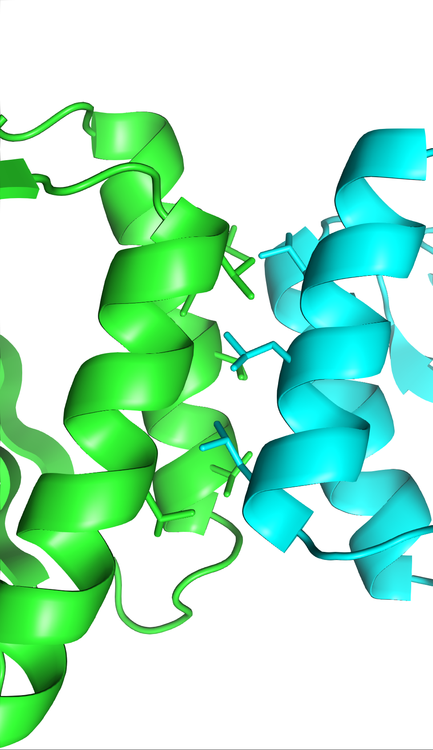
Binder Design Workflow
complex
generation
sequence design
analysis
in-silico
 | Sc
 | worstfrag
 | forward docking
 | forward folding
 | …

Slide 3
Binder Design Workflow
complex
generation
sequence design
analysis
in-silico
why this step?
because there are billions* of times more binding modes than we can run rosetta design on
*grid resolution, blah blah

Slide 4
hypothesis? tautology?
complex
generation
sequence design
analysis
in-silico
markov property:
P( orderable | docking, design ) = P( orderable | design )
Docking has to get side-chain details right
to produce designable interfaces

Slide 5
many approaches, but few (none?)
few model side-chain detail & mutation
global approaches
FFT Docking (zdock, others)
centroid grid searches
top-down stochastic
centroid monte-carol (RosettaDock)
autodock
bottom-up approaches
Patchdock
netmotif
hotspot placement methods
others no doubt
complex
generation

Slide 6

Binder Design Workflow
complex
generation
sequence design
analysis
in-silico
Goal: develop a global “docking+design” method

Slide 7
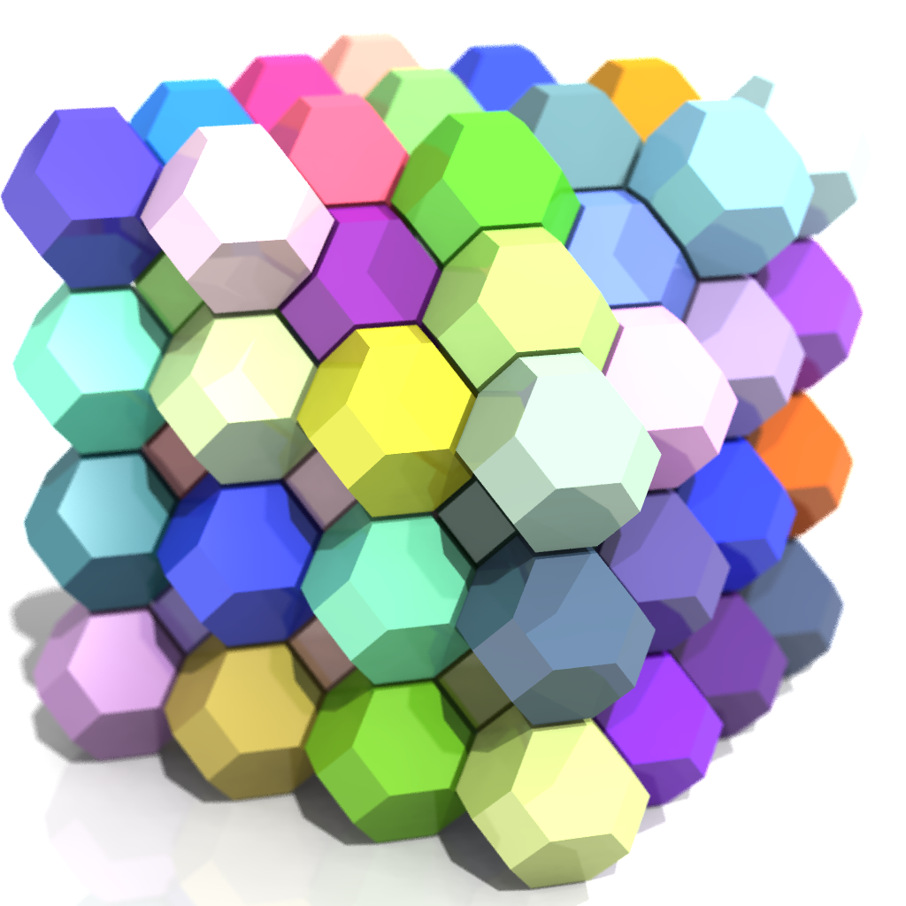
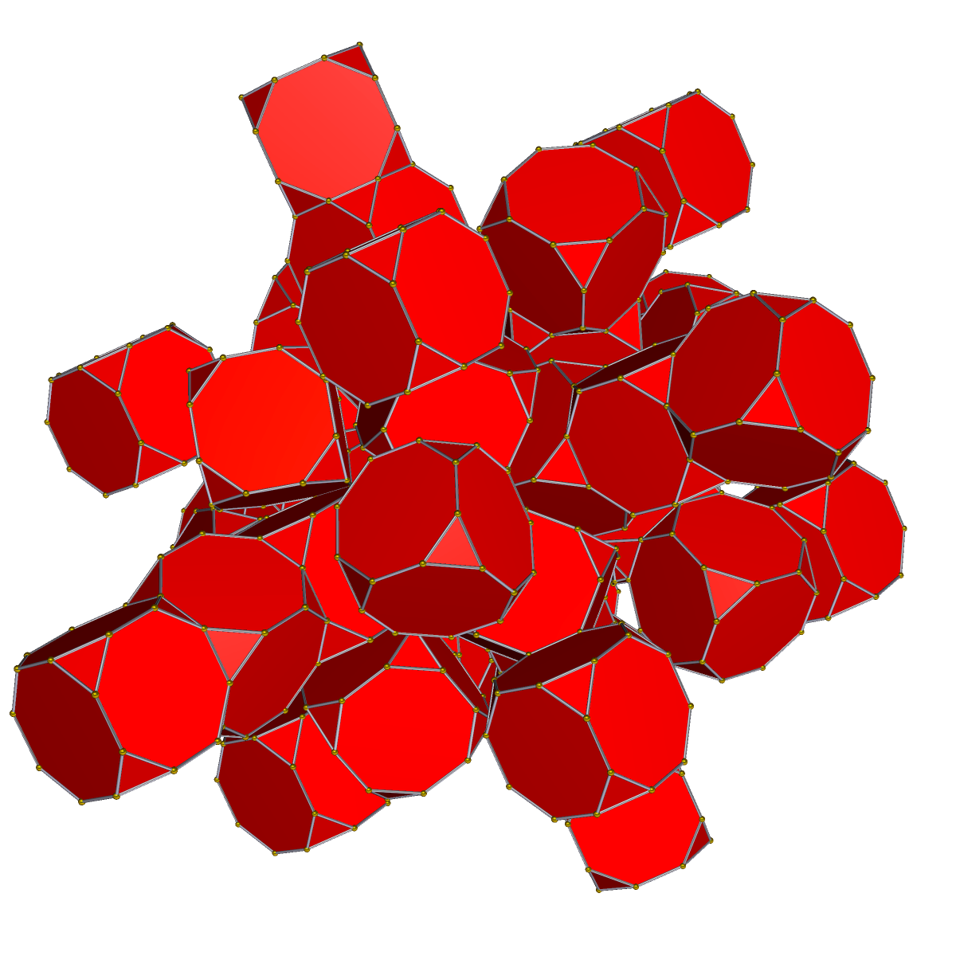
RIF docking
(rotamer interaction field)*
for one-sided design to a fixed target
small-molecule or protein (or other)
high resolution, global(ish) 6D grid search
>10,000x more points than, say, zdock
fancy search technique to make this tractable
scoring & design using RIF technology
rapidly approximates result of design calculation
constraint system for true global search
allows very fast packing calculations >1000x rosetta
*name & many ideas from Alex Ford

Slide 8
generate
RIF
docking into RIF
Pack w/rif rotamers
Rosetta score and/or min
rifgen
rifdock
once per target
(hours)
foreach scaffold
(minutes per)

Slide 9
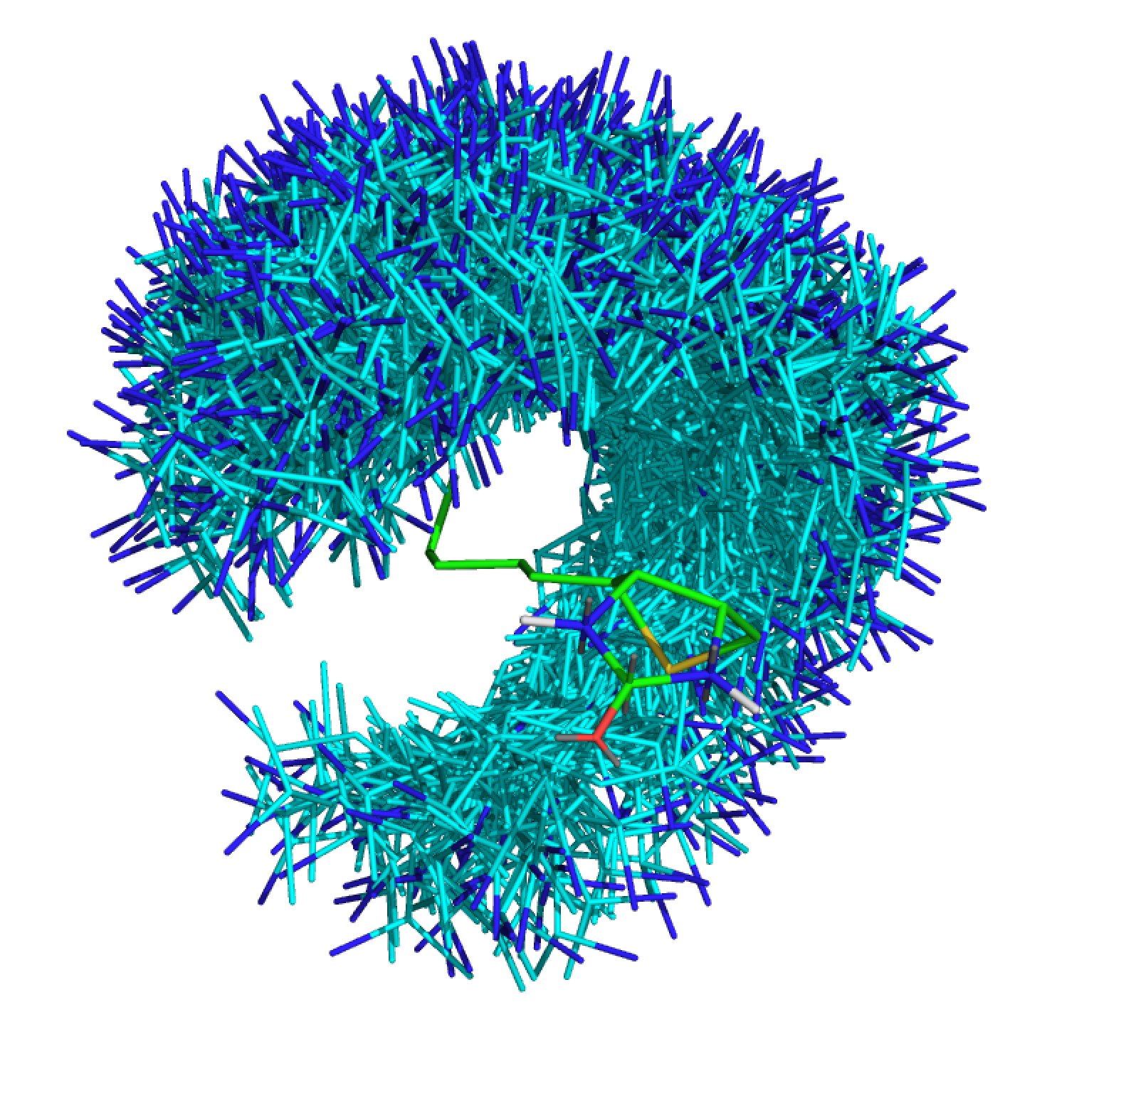
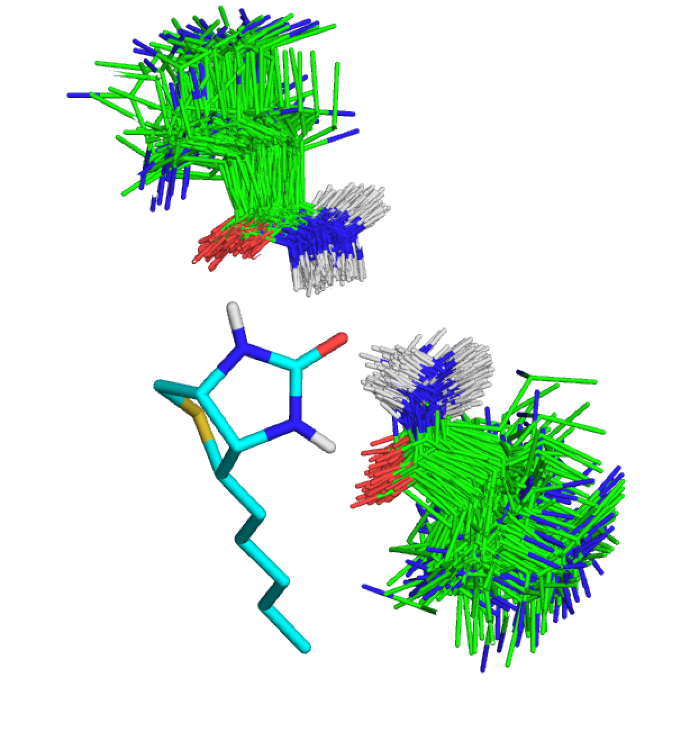
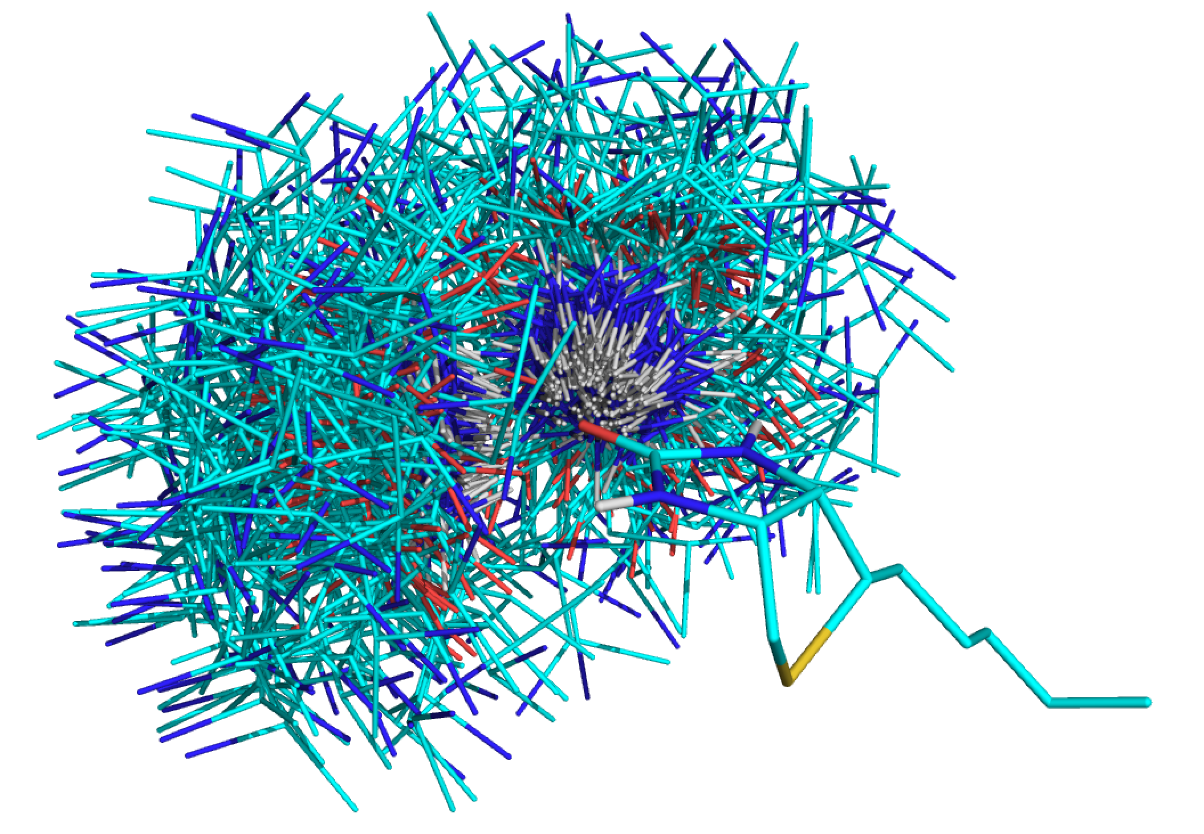
rotamer interaction field
usually 10’s of billions of inverse rotamers
store (approx.): score v. tgt + bb position + rotamer id (+…)
allows very-fast lookup of rotamers given bb position
generate
RIF
docking into RIF
Pack w/rif rotamers
Rosetta score and/or min

Slide 10

BB xyz frame
BB xyz frame
BB xyz frame
BB xyz frame
BB xyz frame
~10¹⁵ scaffold
positions to check!
at each position,
check all backbone
stubs against the RIF
to get a score
4
Target
(ligand, protein surface, metal site, theozyme…)
2
generate
RIF
docking into RIF
Pack w/rif rotamers
Rosetta score and/or min

Slide 11
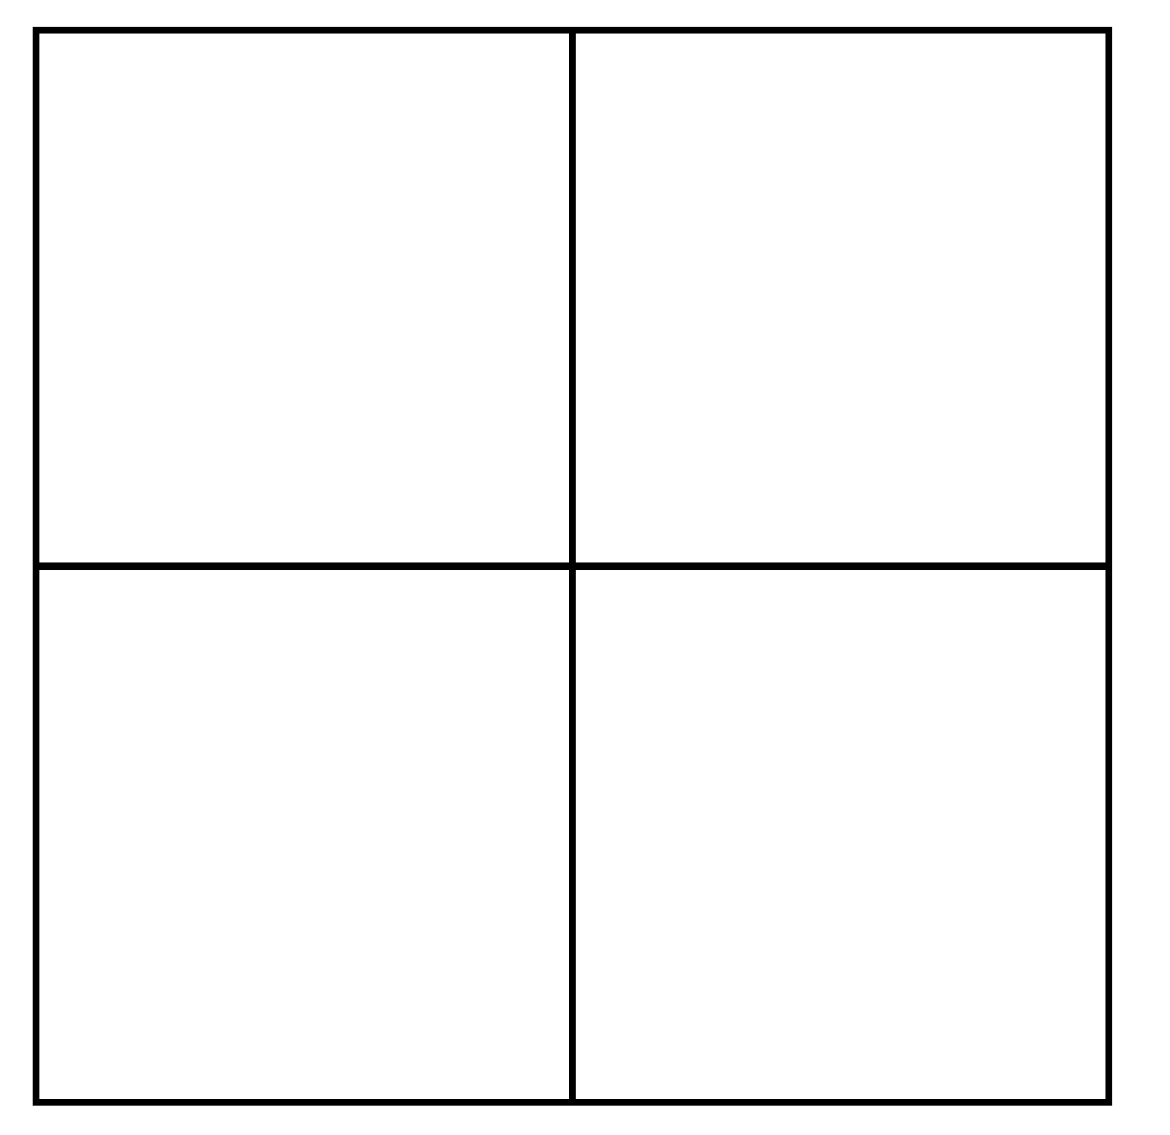
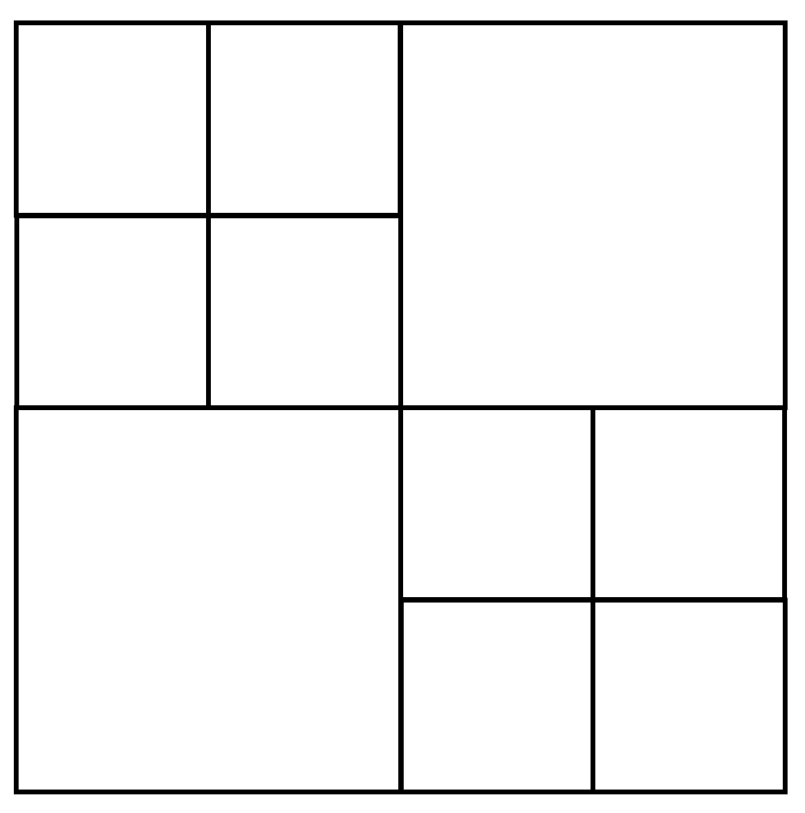
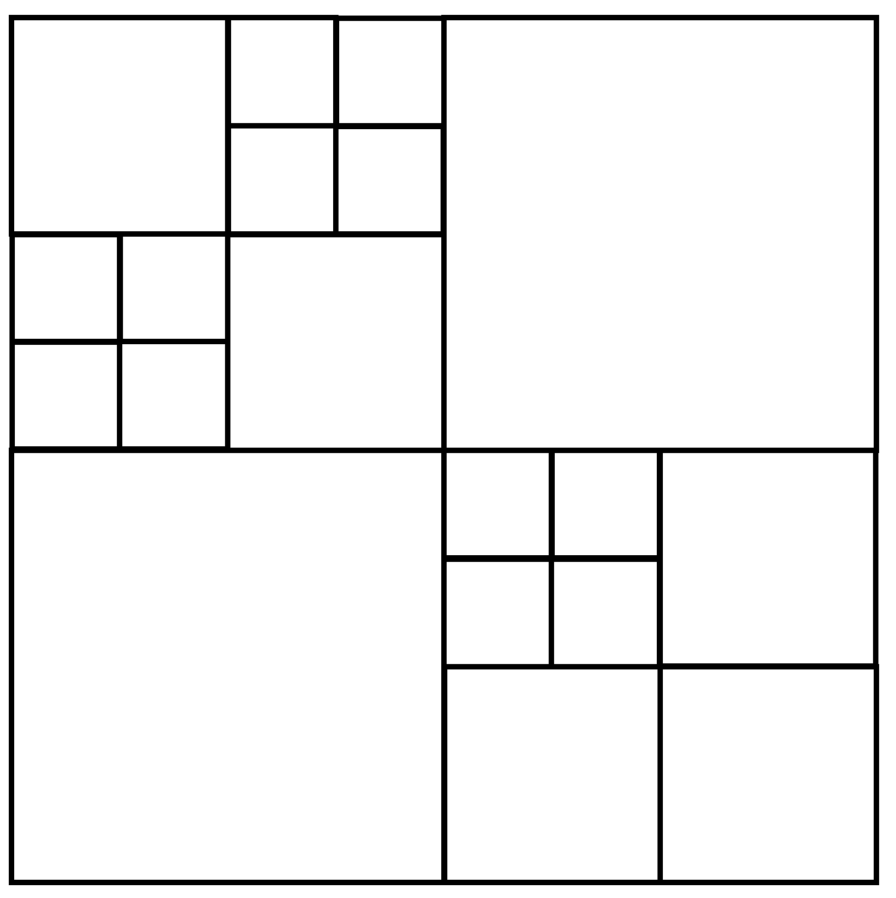
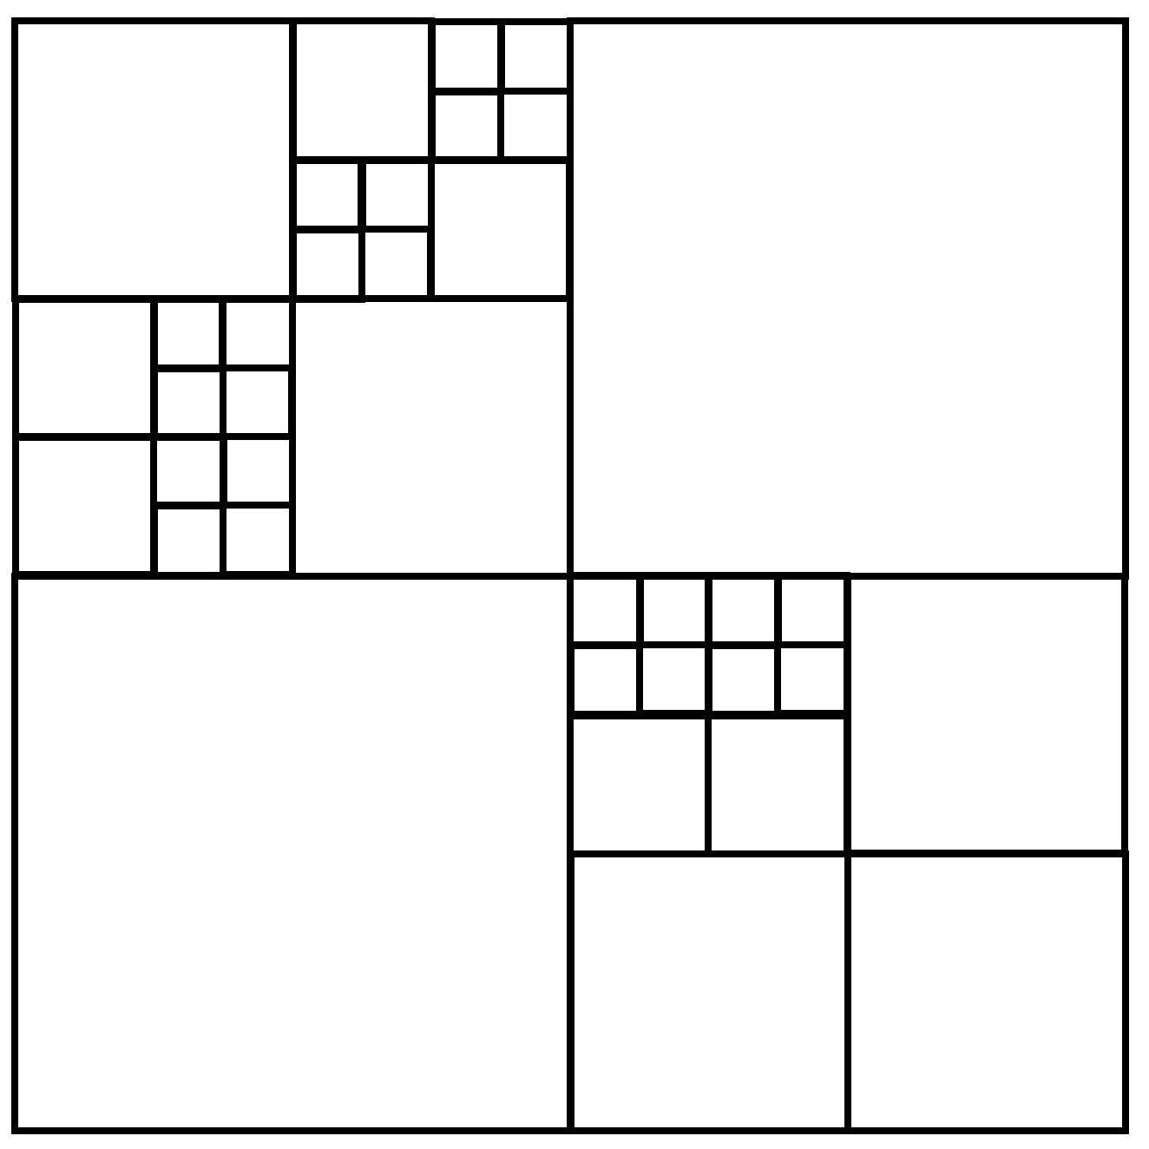
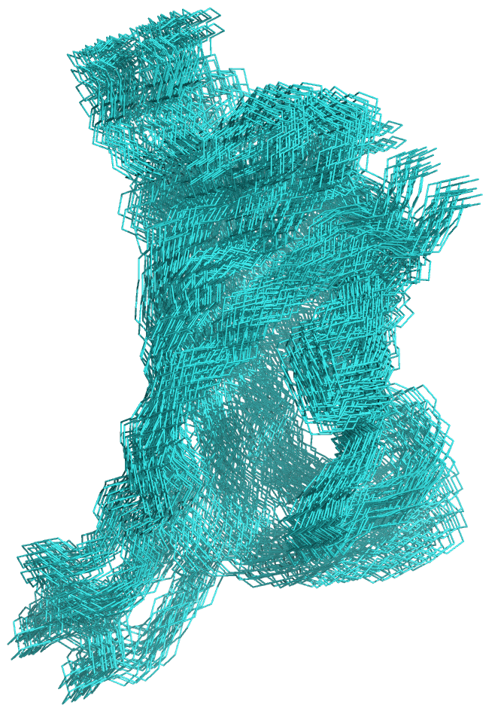
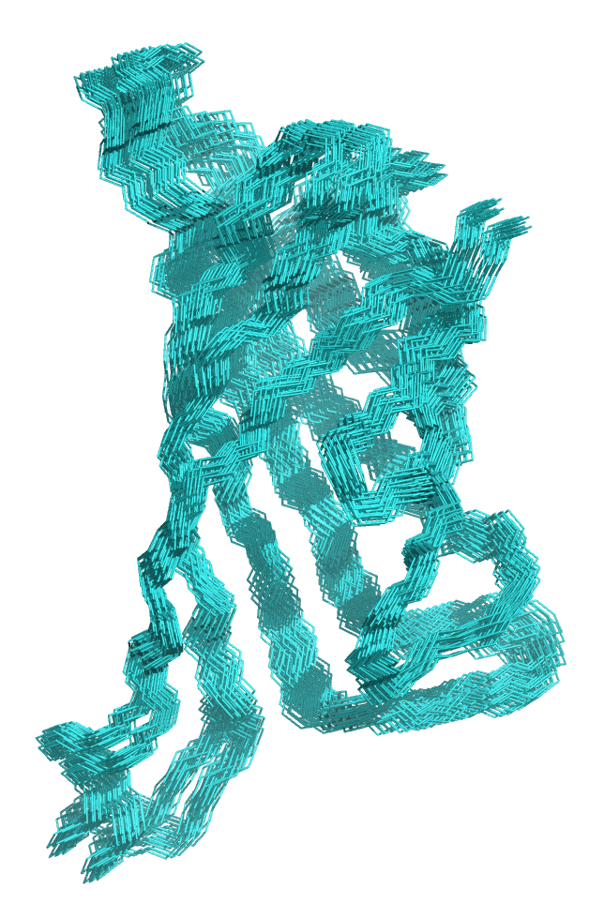
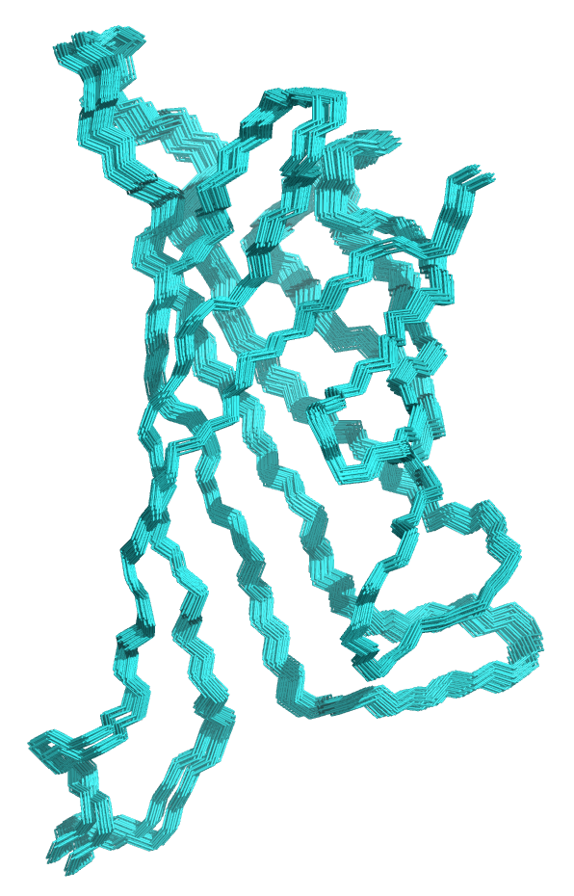
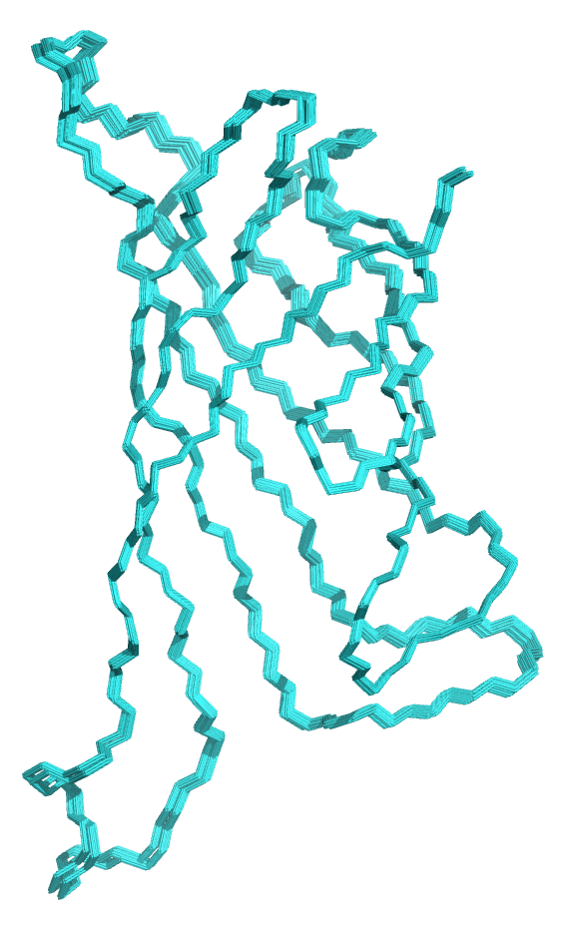
Hierarchical Search Using Bounding Functions
search
grid
ensemble
in grid
generate
RIF
docking into RIF
Pack w/rif rotamers
Rosetta score and/or min

Slide 12
RIF-design
design calculation via monte-carlo, like in rosetta
1,000-10,000 interface designs per second (per core)
use only rotamers from the RIF
~100x reduction in number of rotamers
comparable results to design will all rotamers
reuse scaffold two-body energy table
other technical stuff…
generate
RIF
docking into RIF
Pack w/rif rotamers
Rosetta score and/or min

Slide 13
re-scoring with rosetta (temporary?)
RIF energy function, currently poor match with beta_nov15
temporary solution: re-score rif docks w/beta_nov15
only evaluate about 0.5% of the RIF designs
rifdock takes twice as long
probably good stuff in that other 99.5%…
bad
real solution: fix RIF energy function
generate
RIF
docking into RIF
Pack w/rif rotamers
Rosetta score and/or min

Slide 14
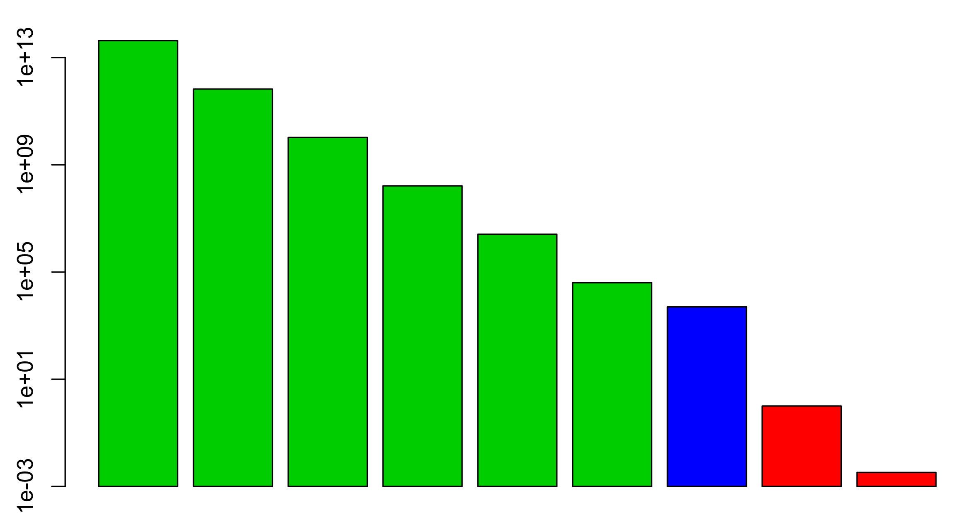
relative usage of
compute resources
“Samples” per second per core
RIF
16Å
“1e14”
RIF
8Å
“1e12”
RIF
4Å
“1e10”
RIF
2Å
“1e8”
RIF
1Å
“1e7”
RIF
0.5Å
~1e5
RIF
Pack
~1e4
Ros.
Sc/Min
~1e1
Ros.
Design
~1e-2
generate
RIF
docking into RIF
Pack w/rif rotamers
Rosetta score and/or min

Slide 15
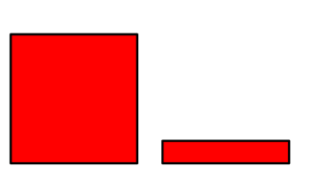
some recent additions
not in release by default
because they don't work
?
RIF
16Å
~1e14
RIF
8Å
~1e12
RIF
4Å
~1e10
RIF
2Å
~1e8
RIF
1Å
~1e7
RIF
0.5Å
~1e5
RIF
Pack
iface
~1e4
RIF
Pack
iface
ExRots
~1e3
RIF
Pack
Whole
Scaffold
~1e2 ??
Ros.
Sc/Min
~1e1
Ros.
Design
~1e-2
cool parent/child rotamers approach
works, technically, (rif scores improve)
but worse beta_nov15 scores! crap!
repack region around
interface design
(not in release)

Slide 16
RIF constraints
° store some extra data for each rotamer in the RIF
can enforce non-pairwise properties
like, every polar on my ligand must be satisfied
° possible applications:
require polar satisfaction
require user-defined hotspots
require surface coverage

Slide 17
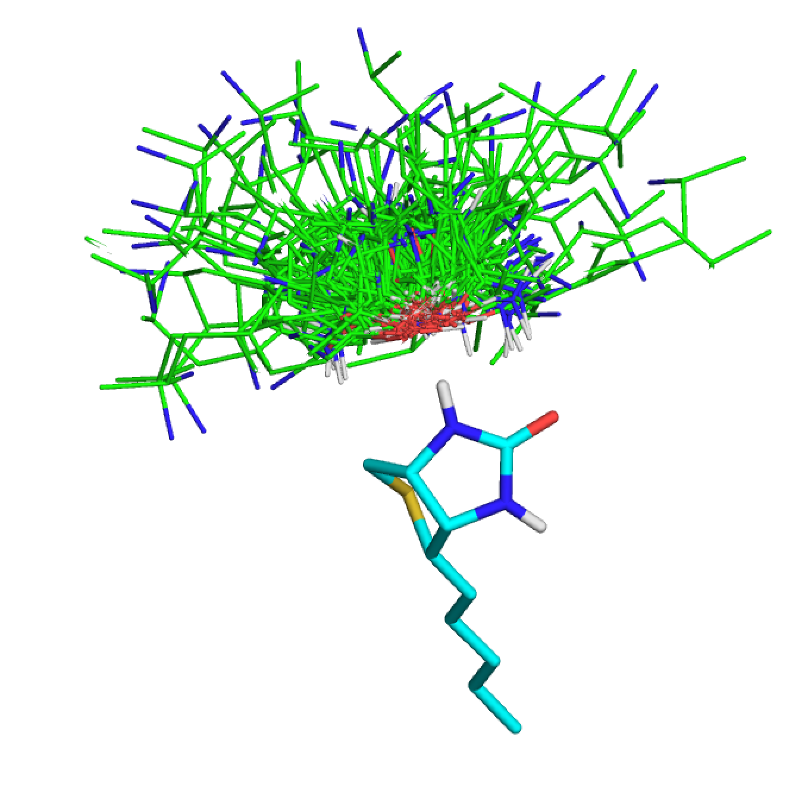
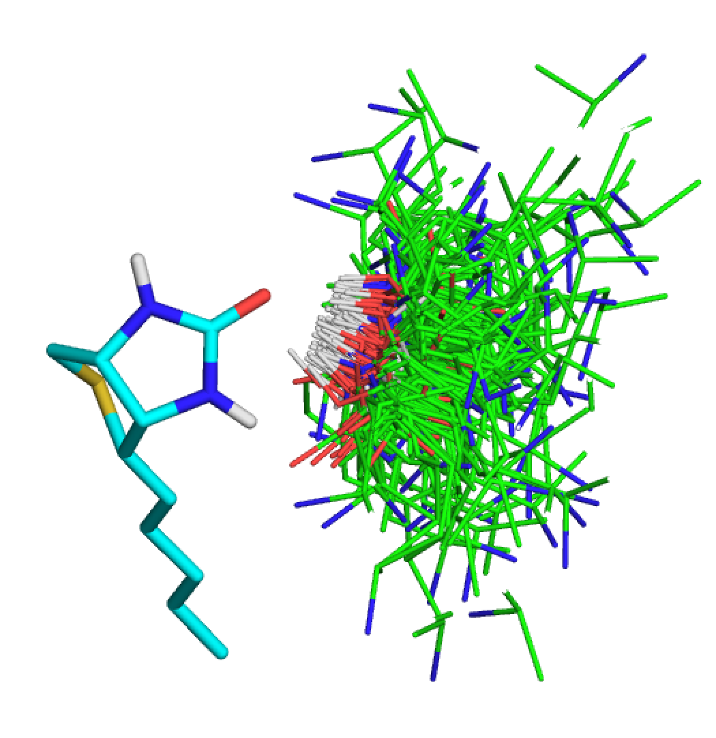
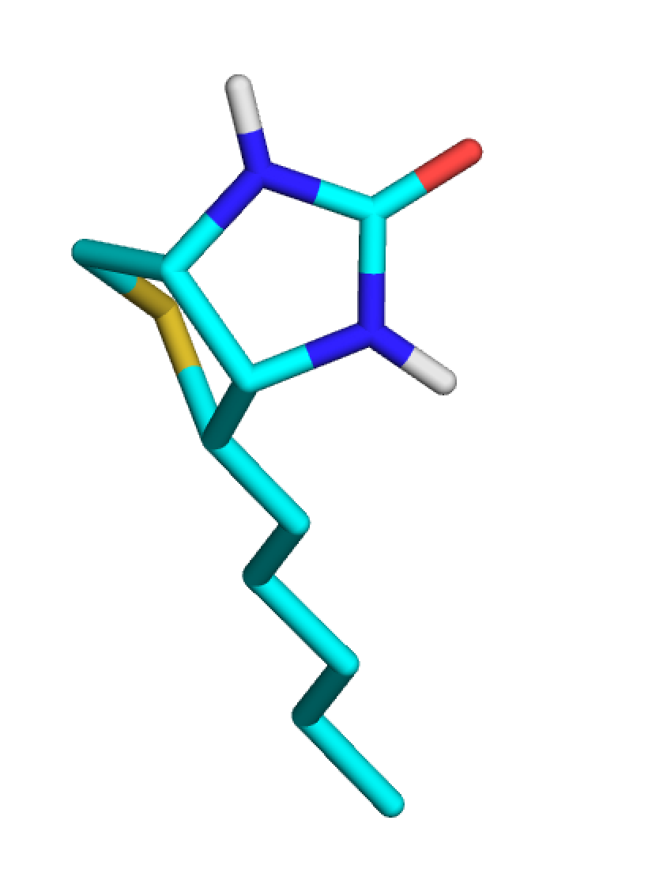
Constraints Example: Polar Satisfaction
1
1
2
3
3
1
2
4
3
-
4

Slide 18
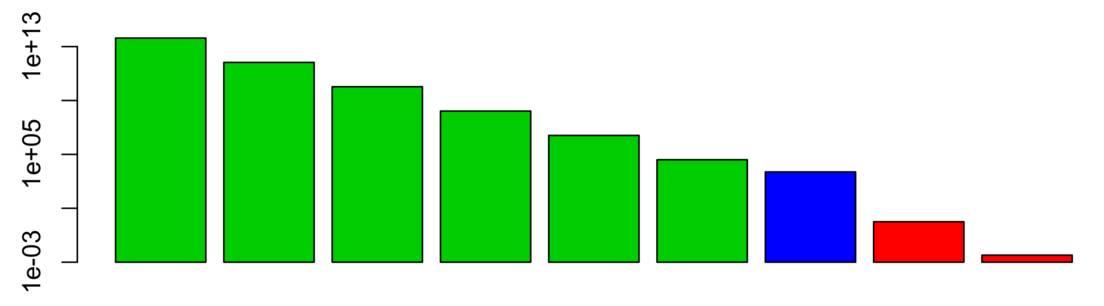
Filters applied
at the end
???
knowledge is applied to only a few designs
RIF constraints, applied
all the way through
???
knowledge is applied to everything

Slide 19

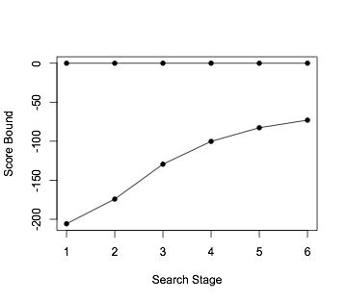
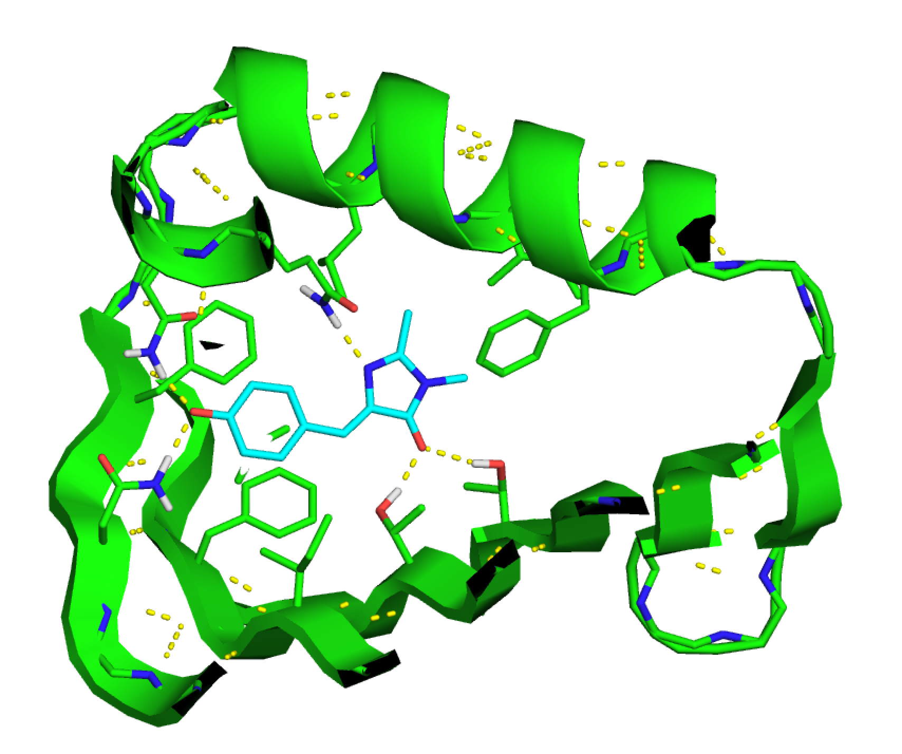
With constraints, in some cases, can
guarantee all possible solutions found
level of rigor in computational protein
design raised from 0 to 0.00000001
Score range by search stage
16Å 8Å 4Å 2Å 1Å 0.5Å

Slide 20
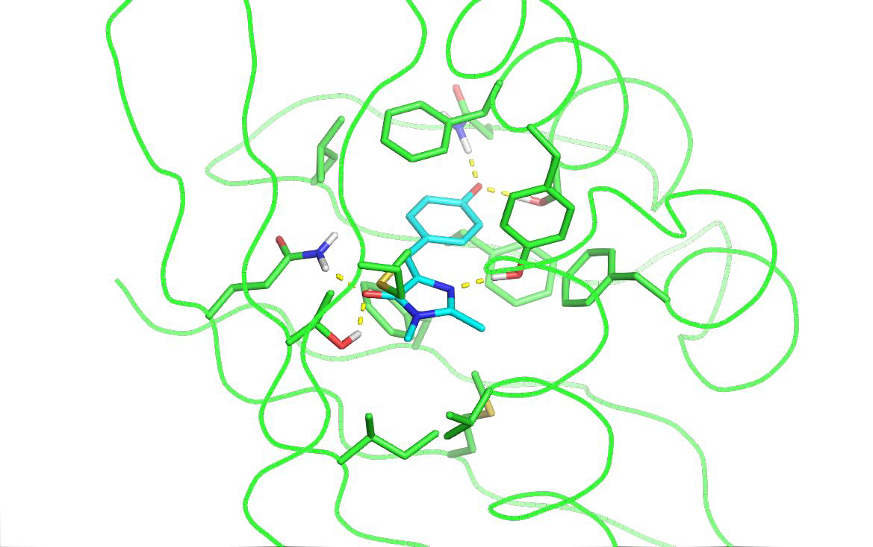
satisfaction constraints help balance polar/hydrophobic

Slide 21
RifDock >> Matcher (??)
faster (??), easier, more universal: one tool for PPI and ligands
hydrophobic as well as polar interactions
capable of finding more complex binding modes 3ish vs 6ish hydrogen-bonding residues
geometries good… no heavy-handed constraints necessary (??)
head-to-head test with biotin: RIF better by ~5 REU and ~0.1 Sc on average

Slide 22
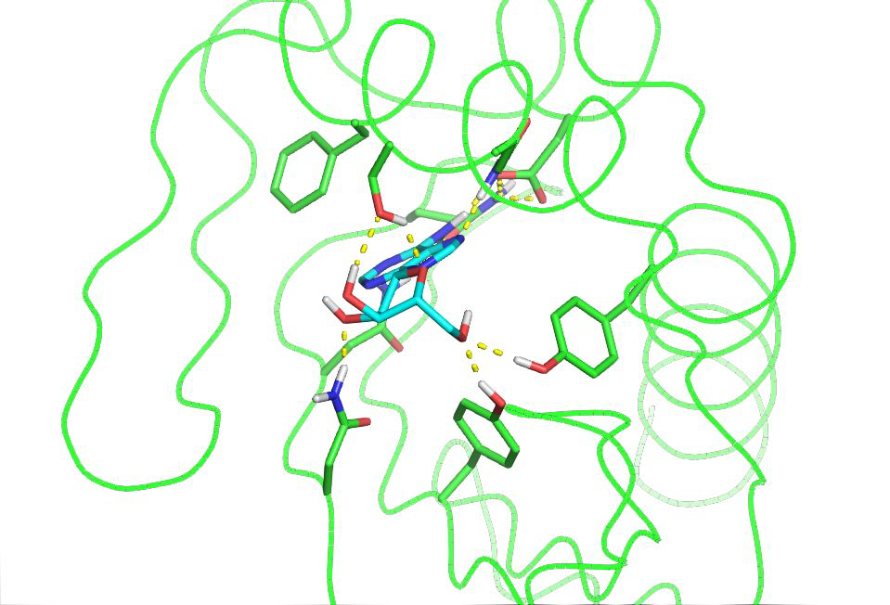
can find quite complex binding sites

Slide 23

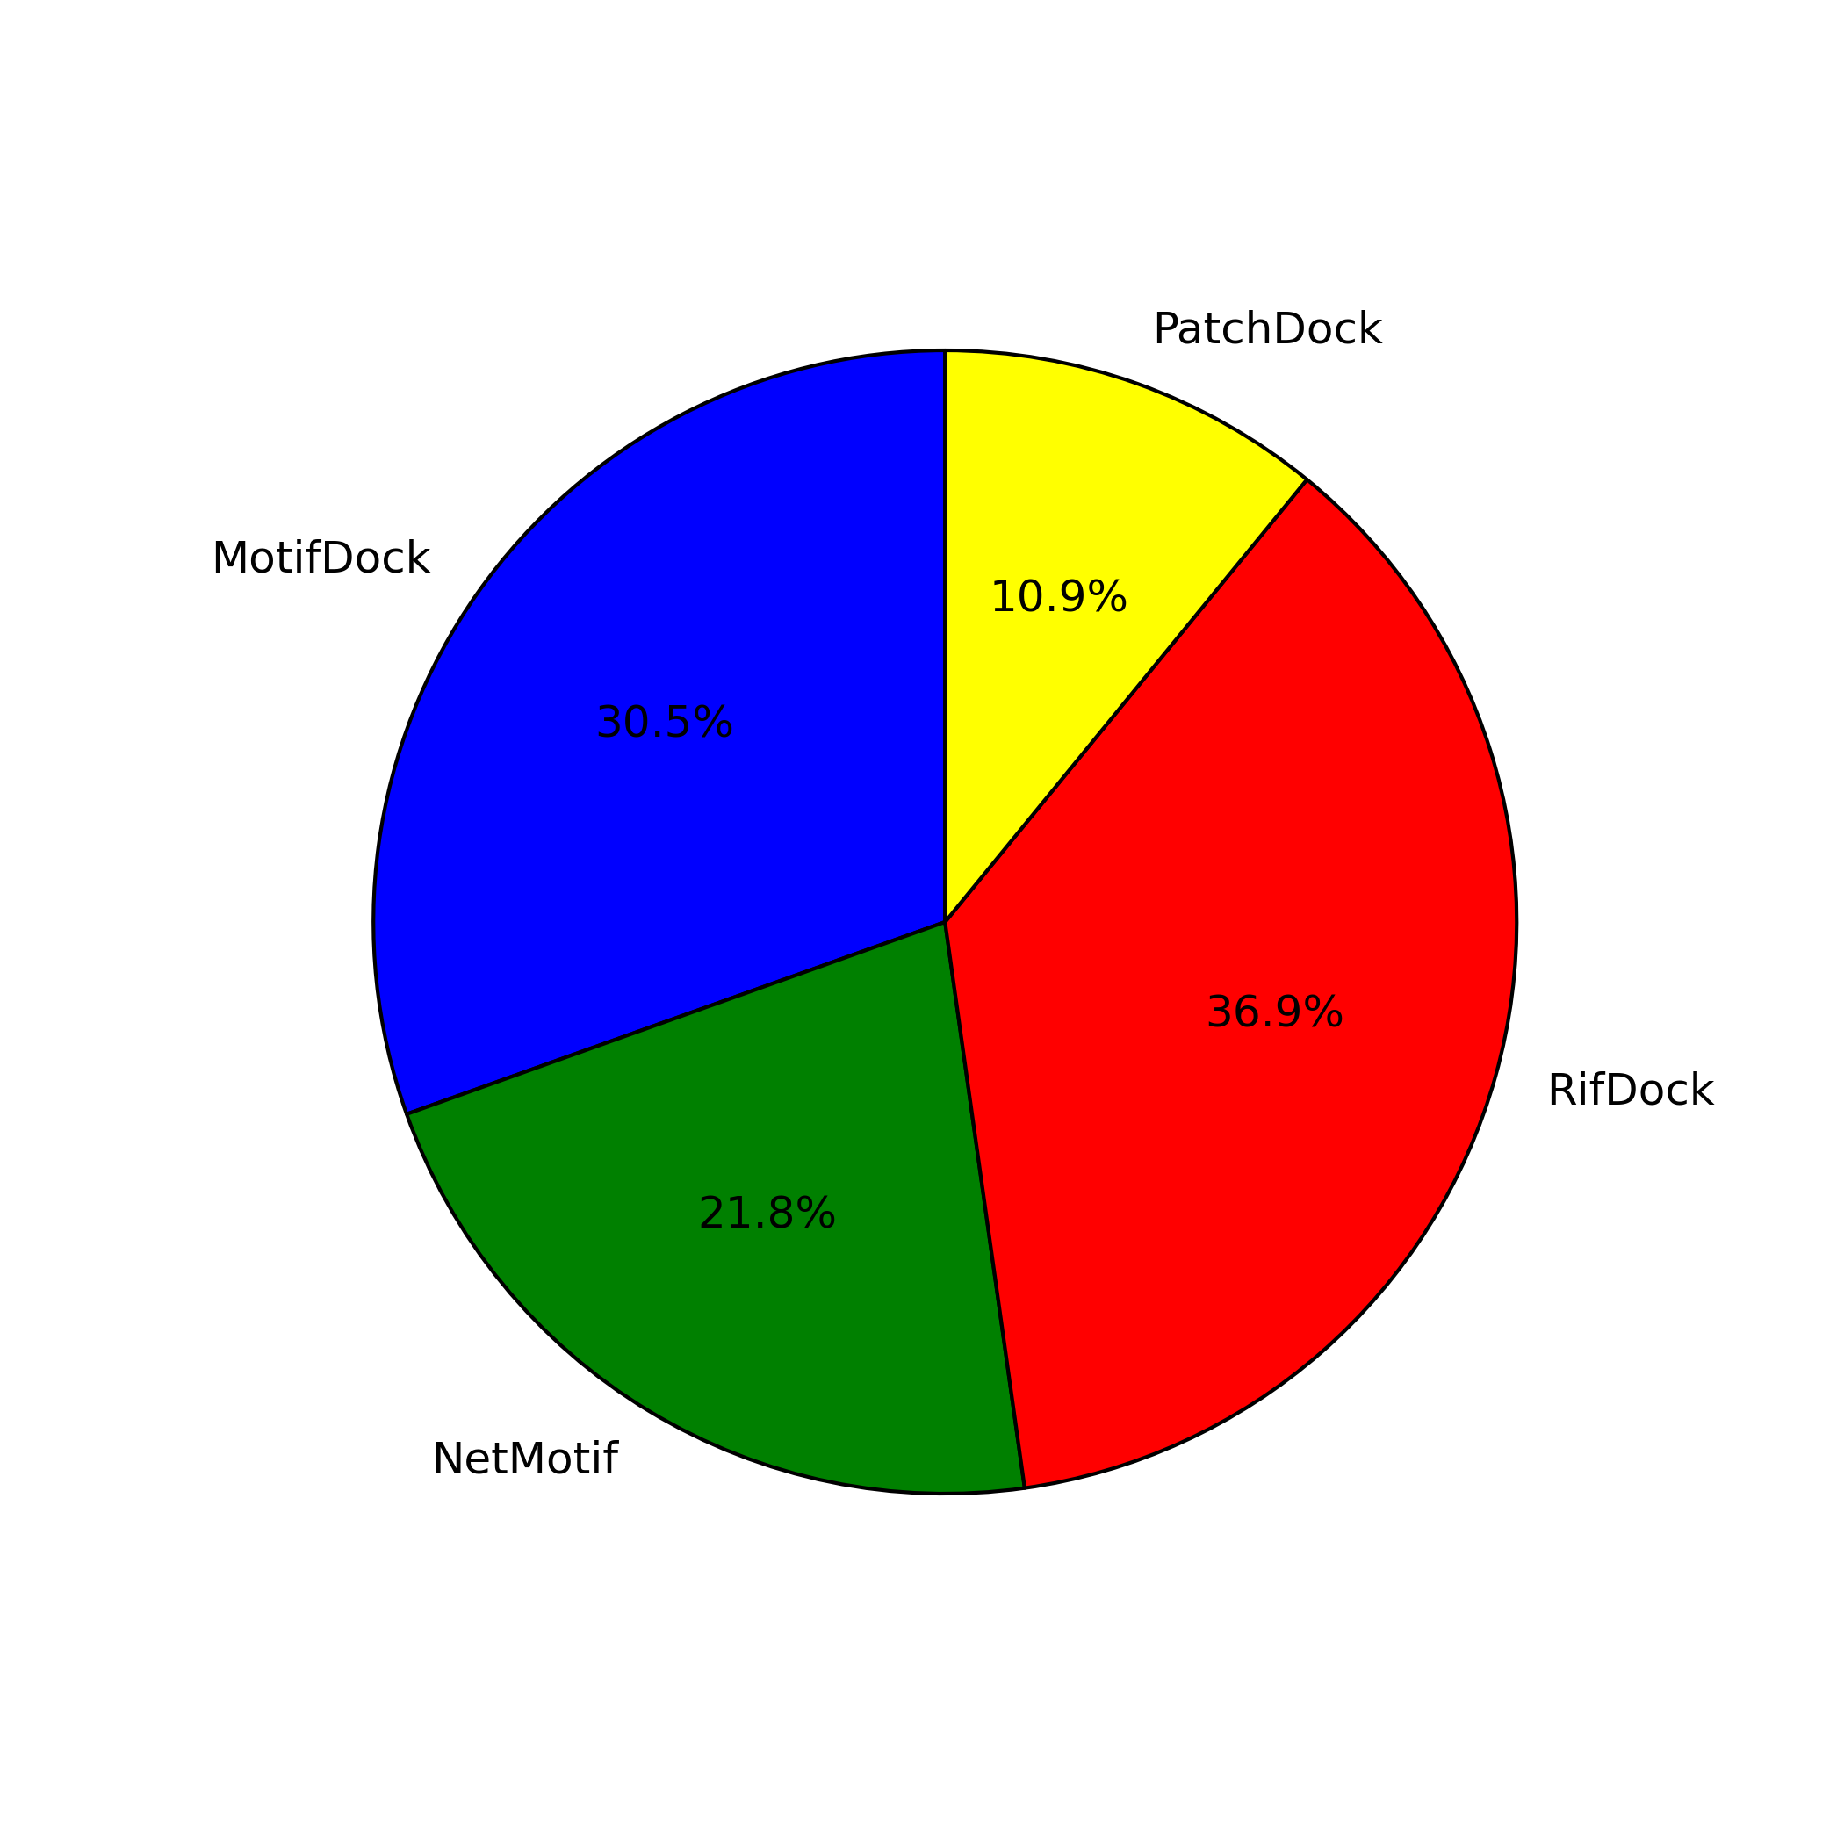
PPI Bench V1: sad face
MotifDock
NetMotif
RIFDock
PatchDock
criteria
Ddg_fa_atr_norepack_1000SASA <= -30
Interface_buried_sasa => 1100
Interface_sc => 0.65
Unsat_buried_hbonds2 <= 3
Worstfrag <= 1.5
n = 5664
thanks Franziska, Danny, Phillip, et. al.

Slide 24
What went wrong in PPI bench V1?
very early version of rifdock => bugs
many misc. technical improvements:
rif energy function doesn’t match beta_nov15
better selection of mutable scaffold positions and better integration with fixed core residues
user’s target residue selection very important
must select every residue touching the target area!
initial results looked deceptively good, so I didn’t pay attention until it was too late

Slide 25
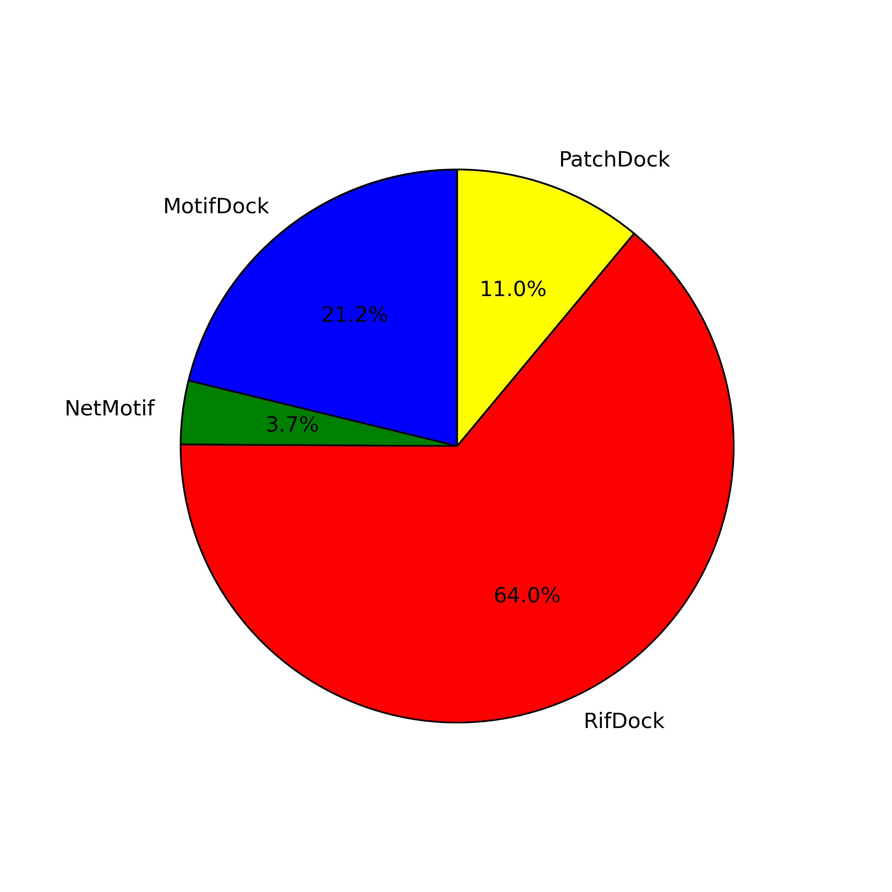
PPI Bench V2: happy/smug face
(latest released RifDock v4)
MotifDock
NetMotif
RIFDock
PatchDock
criteria
Ddg_fa_atr_norepack_1000SASA <= -30
Interface_buried_sasa => 1100
Interface_sc => 0.65
Unsat_buried_hbonds2 <= 3
Worstfrag <= 1.5
n = 4119
preliminary, 5/7 targets, no CTLA4 & TrkA2, criteria not finalized

Slide 26
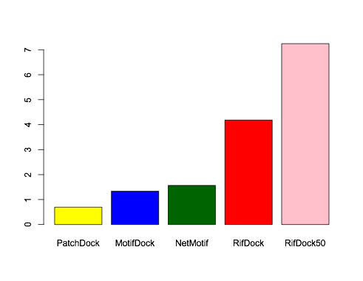
Fraction passing original ordering criteria
Percent
netmotif success rate not bad, just low counts

Slide 27
Fraction passing original ordering criteria
in future, maybe better to output more docks and rank them rather than per-scaffold quota
Percent
exactly 10 docks
per scaffold
remove bottom
half by dock score

Slide 28
hypothesis: docking success relates to degree of sidechain “awareness”
models mutations
implicitly, poorly
Percent
does not
model mutations
may correlate
with native “packability”
(on scaffold side only)
models mutations
explicitly

Slide 29
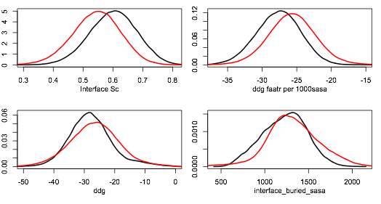
Overall Distributions
RIF
other
RIFdock interfaces smaller but better on average
Interface Sc
DDG fa_atr / 1000 sasa
DDG
Interface SASA

Slide 30
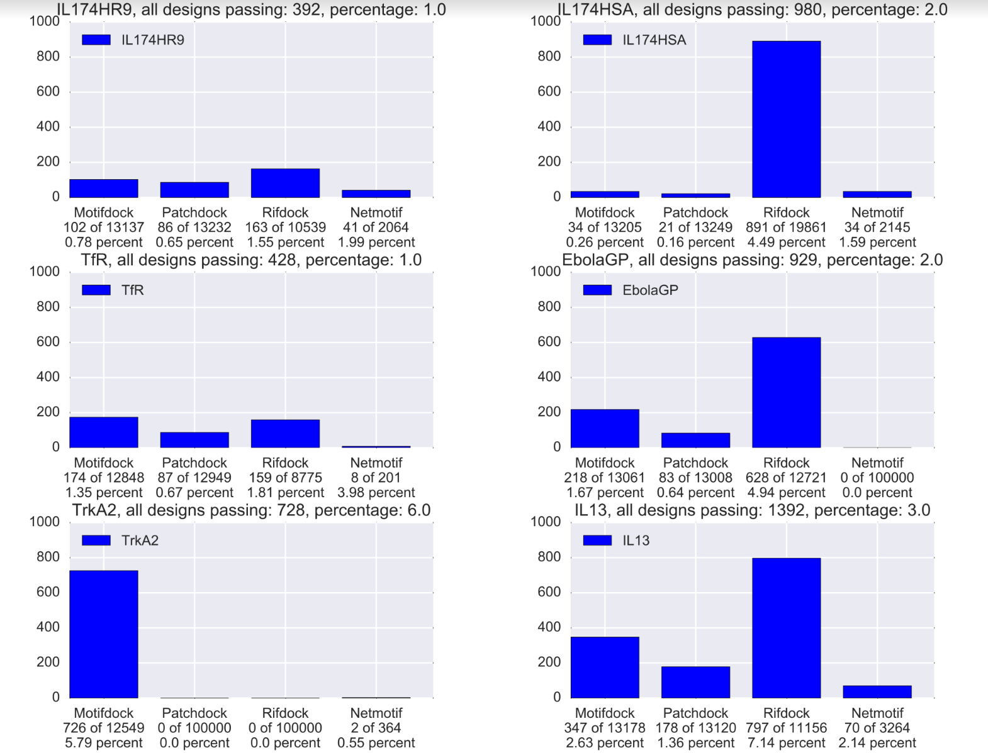
RIFdock fairly consistent results across targets
preliminary, 5/7 targets, no CTLA4 & TrkA2, criteria not finalized

Slide 31
major outstanding issues
RIF energy function needs to match beta_nov15
maybe not h-bond energy… but all other 2body
better handling of extra rotamers & integration with scaffold
conformers / target flexibility
proton-chis < side-chain < backbone
improve h-bond constraints & implement other types of constraints
how to place “networked” rotamers in groups?
make data formats more rigorous/portable (hdf5?)
C++ really sucks

Slide 32
diminishing returns?
harder to find the low-hanging fruit
worthwhile new features are taking more work than before
been working on this exclusively for 18 months…
RIF docking is, maybe, almost, “good enough” for
small molecule binders (and enzdes?)
protein-protein interface design
I may start spending some time on new projects, finally
(probably not)

Slide 33
possible projects
possible new RIF applications
scaffold design via fragment-merging (peptides? whole or partial scaffolds?)
“RIF” style two-sided design (could help many one-sided design apps as well)
structure prediction / forward docking?
generation of small, complete polar networks (Gerard)
non-RIF stuff
divide and conqueror topologies for scaffold gen
on-the-fly hb network search w/ waters

Slide 34
I forget
lots of people
THANKS!
Ideas &
Discussion
Alex
Jorge
Daniel
Scott
Gerard
Semi-happy Users
Ralph
Jaiyi
Gerard
Benjamin
other SM folks
Hua
Franziska
Danny
Philip
Eva
other PPI bench folks

Slide 35
A little more detail…
(optional)

Slide 36
What is a RIF?
contain ~10 billion inverse rotamers
store (approx.): score v. tgt + bb position + rotamer id
logically, like a giant set of hotspots (but less picky)
donors to BTN
leu(80) 1.4

Slide 37
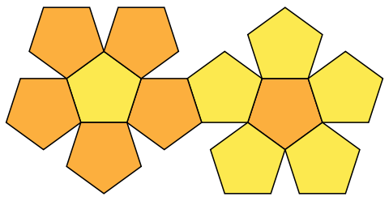
how RIF is stored (sparse, resolution ~0.6 A)
6D BCC
Lattice
6D BCC
Lattice
RIF
ROT# | Score
7 | -3.14
392 | -2.718
81 | -1.3
13 | -1.0
flattened
dodecahedron
“flattened”bitruncated 24-cell
(tetracontoctachoron)
imgs: wikipedia

Slide 38
Docking Into RIF
BB xyz frame
BB xyz frame
BB xyz frame
BB xyz frame
kinda like docking into a 6D density
but in addition, also store rotamers in RIF:
BB xyz frame
4
Target
(ligand, protein surface, metal site, theozyme…)
RIF
ROT# | Score
7 | -3.14
392 | -2.718
81 | -1.3
13 | -1.0
2
problem: ~100 trillion configurations to search at resolution necessary for rotamer placement

Slide 39
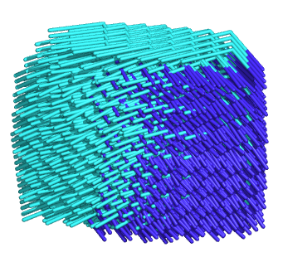
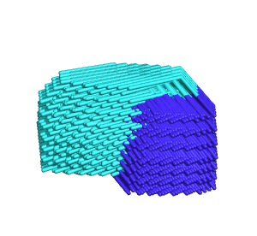
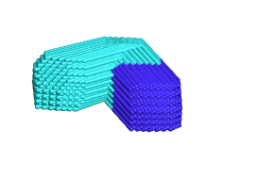
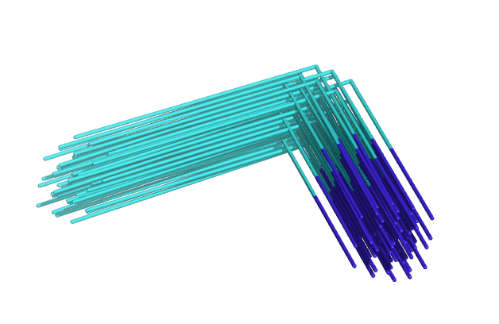
Hierarchical Search Using Bounding Functions
search
grid
ensemble
in grid
single
residue
r=8
r=4
r=2
r=1

Slide 40
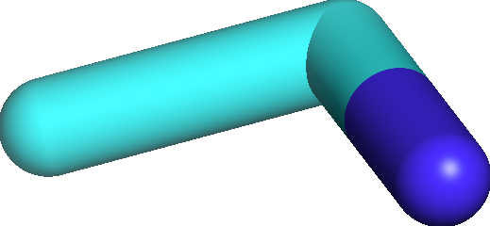
Bounding Functions
“Raw” Grid
“Bounding” Grid

Slide 41



Objective Function Used in Docking (very fast)
E( scaffold, target )
+
E( rotamers, target )
+
E( rotamers, scaffold )
+
E( rotamers , rotamers )
+
E( scaffold, scaffold )
+
E( target, target )
R
S
Etot =
T

Slide 42

Objective Function Used in Docking (very fast)
E( scaffold, target )
+
E( rotamers, target )
+
E( rotamers, scaffold )
+
E( rotamers , rotamers )
+
E( scaffold, scaffold )
+
E( target, target )
R
S
Etot =
T
Fixed

Slide 43
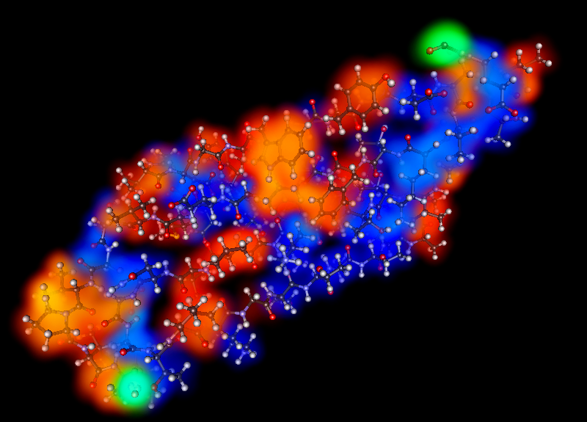


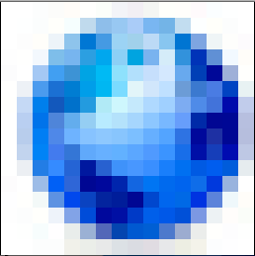
Objective Function Used in Docking (very fast)
E( scaffold, target )
+
E( rotamers, target )
+
E( rotamers, scaffold )
+
E( rotamers , rotamers )
+
E( scaffold, scaffold )
+
E( target, target )
good approx. using 3D grids
atoms of smaller vs grid of larger
Example:
Etot =
VDW+
SOL+ELEC

Slide 44
Objective Function Used in Docking (very fast)
E( scaffold, target )
+
E( rotamers, target )
+
E( rotamers, scaffold )
+
E( rotamers , rotamers )
good approx. using 3D grids
atoms of smaller vs grid of larger
looked up in precomputed
“Rotamer Interaction Field” (RIF)
Etot =
BB xyz frame
BB xyz frame
BB xyz frame
BB xyz frame
BB xyz frame
2
Target
3

Slide 45

Objective Function Used in Docking (very fast)
E( scaffold, target )
+
E( rotamers, target )
+
E( rotamers, scaffold )
+
E( rotamers , rotamers )
good approx. using 3D grids
atoms of smaller vs grid of larger
looked up in precomputed
“Rotamer Interaction Field” (RIF)
Etot =
lookup rotamers in RIF, then
lookup each rot in precomputed
1-body energy table for scaffold
Scaffold 1B
ROT# | Score
… | …
7 | 11.3
392 | 0.3
81 | -1.5
13 | 2.7
… | …
RIF
ROT# | Score
7 | -3.14
392 | -2.718
81 | -1.3
13 | -1.0
TOT
ROT# | Score
7 | 14.44
392 | -2.418
81 | -2.8
13 | 2.7
+
=

Slide 46
Objective Function Used in Docking (very fast)
E( scaffold, target )
+
E( rotamers, target )
+
E( rotamers, scaffold )
+
E( rotamers , rotamers )
+
E( scaffold, scaffold )
+
E( target, target )
good approx. using 3D grids
atoms of smaller vs grid of larger
looked up in precomputed
“Rotamer Interaction Field” (RIF)
Etot =
lookup rotamers in RIF, then
lookup each rot in precomputed
1-body energy table for scaffold
look up in RIF,
looked up in 2-body table,
small packing calculation

Slide 47
E( scaffoldBB, target )
+
E( rotamers, target )
+
E( rotamers, scaffold )
+
E( rotamers , rotamers )
good approx. using 3D grids
LOW-RES: looked up in precomputed
“Rotamer Interaction Field” (RIF)
HIGH-RES: recompute more-accurate
rotamer-target energy
lookup rotamers in RIF, then
lookup each rot in precomputed
1-body energy table for scaffold
LOW-RES: ignored
HIGH-RES: look up candidate rotamers
in RIF, small packing calculation

Slide 48
COMPUTABILITY
Undefined (doesn’t even make sense) | Exponential (utterly terrible) | NotPolynomial (bad, but manageable) | Polynomial (good, mostly) | Whiteboard Math (perfect, but usually fantasy)
Molucular Dynamics (Physical Simulation) | Rosetta (Monte Carlo) | Branch & Bound (my stuff) | Lattice Models(?) Linear Program … | E = MC²
Differentiable Energy Function | Pair-decomposable Energy Function + Kinematic model | Energy Func. with bounding heuristics + hierarchical sampling structure | protein is a cuboid snake of two colors? | Let the protein be a Sphere of radius r…
MODELING POWER (maybe)

Slide 49
Hierarchical Search Using Bounding Functions
search
grid
ensemble
in grid
single
residue
r=8
r=4
r=2
r=1

